Slide 1

INDIAN PREMIER LEAGUE MATCH DATA ANALYSIS (2008 – 2017)
By
Rahul Ega
Sai Rohini Godavarthi

Slide 2

OVERVIEW
Introduction
Objectives
Dataset
Exploratory Data Analysis
- Data Loading
- Data Cleaning
- Data Analysis using Descriptive Statistics
Data Manipulation
- Data Aggregation
Data Visualization

Slide 3

INTRODUCTION
The Indian Premier League is a professional Twenty20 cricket league in India.
It is contested during March or April and May of every year by ten teams representing eight different cities in India.
IPL holds the distinction of being the most-attended cricket league globally. In 2014, it ranked sixth by average attendance among all sports leagues.
The brand value of the IPL reached a staggering US$6.3 billion in 2018, making it one of the most valuable cricket leagues in the world.
According to the Board of Control for Cricket in India (BCCI), the 2015 IPL season contributed a substantial ₹12,543.5 billion to the Gross Domestic Product (GDP) of the Indian economy.

Slide 4
OBJECTIVE
To conduct a comprehensive analysis of Indian Premier League (IPL) match data spanning from 2008 to 2017.
This analysis aims to uncover insights, trends, and patterns within the dataset, providing valuable information about the performance of teams and players, match outcomes, venue preferences, and other key aspects of IPL cricket during this period.
By leveraging the rich dataset containing detailed match-related attributes, the objective is to gain a deeper understanding of the dynamics and evolution of the IPL over the specified timeframe.

Slide 5
DATASET
The dataset contains detailed information on IPL matches played from 2008 to 2017.
It includes match-related attributes such as innings, batting and bowling teams, runs scored, dismissals, match outcomes, player statistics, venue details, and umpire information.
With over 11415 matches recorded, this dataset offers a comprehensive view of IPL cricket during this period.
The dataset was sourced from https://github.com/MainakRepositor/Datasets/tree/master/IPL
The dataset comprises three CSV files: deliveries.csv, matches.csv, and most_runs_average_strikerate.csv.

Slide 6
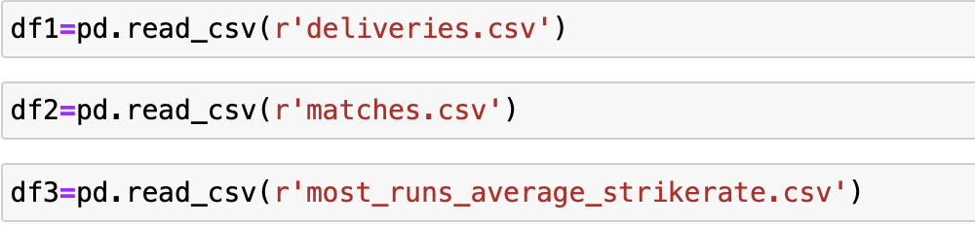
LOADING THE DATASET

Slide 7
DATA CLEANING

Slide 8
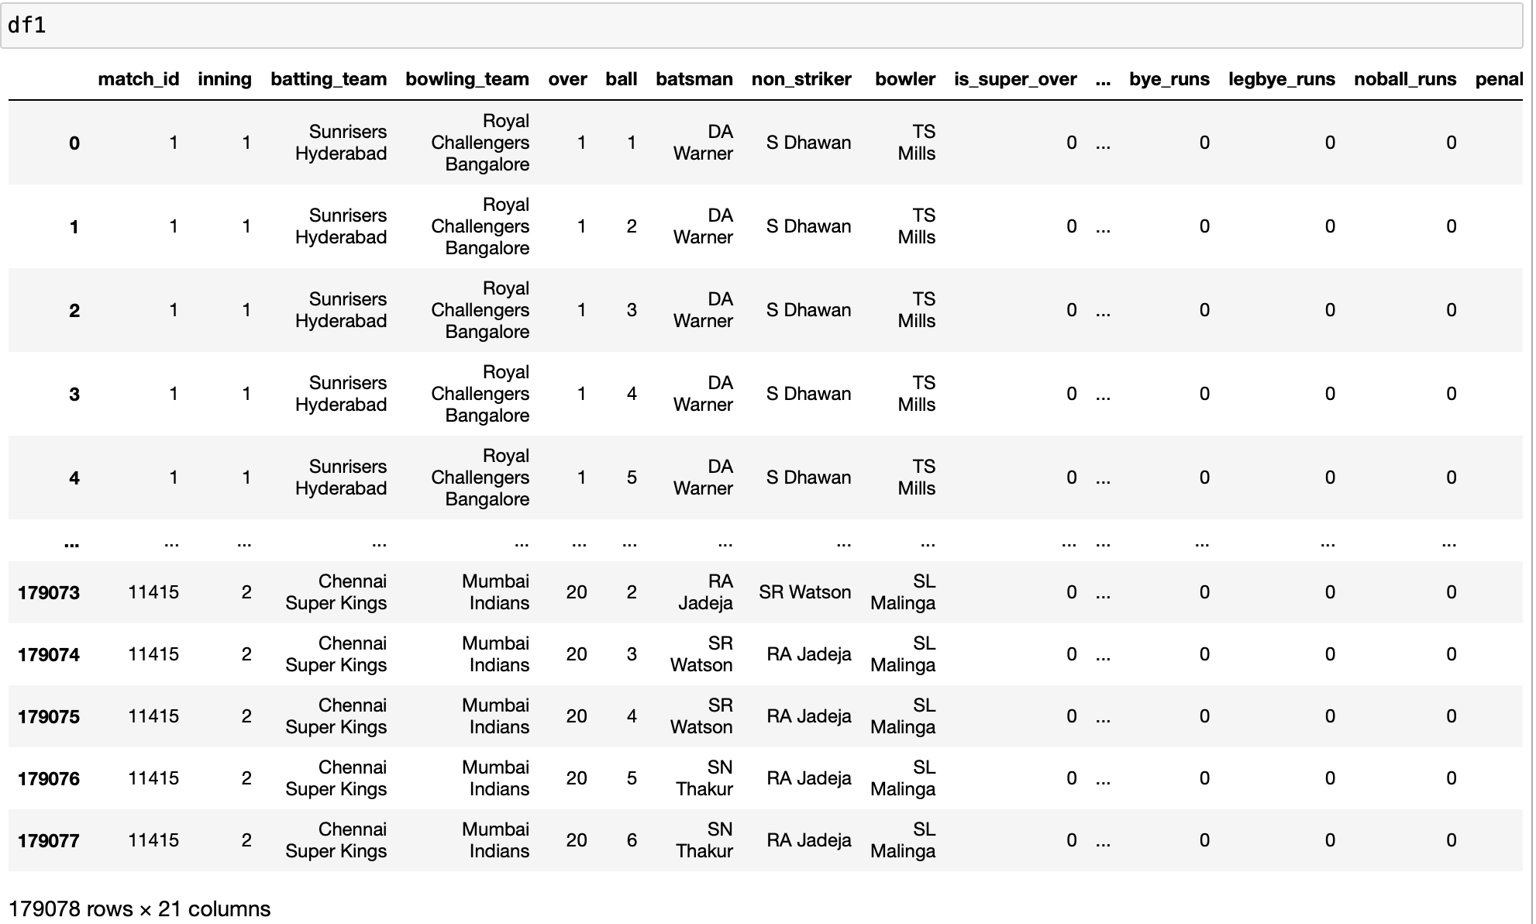
DELIVERIES.CSV

Slide 9
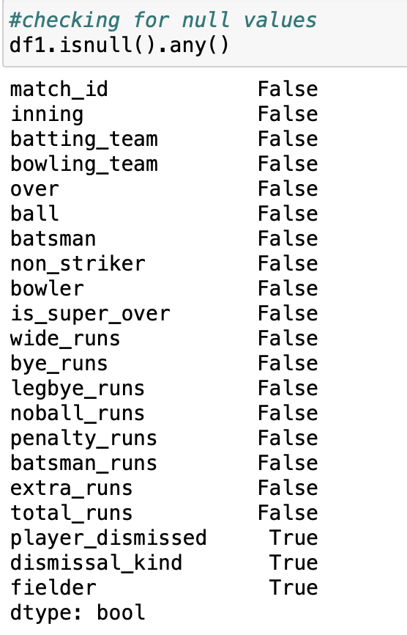
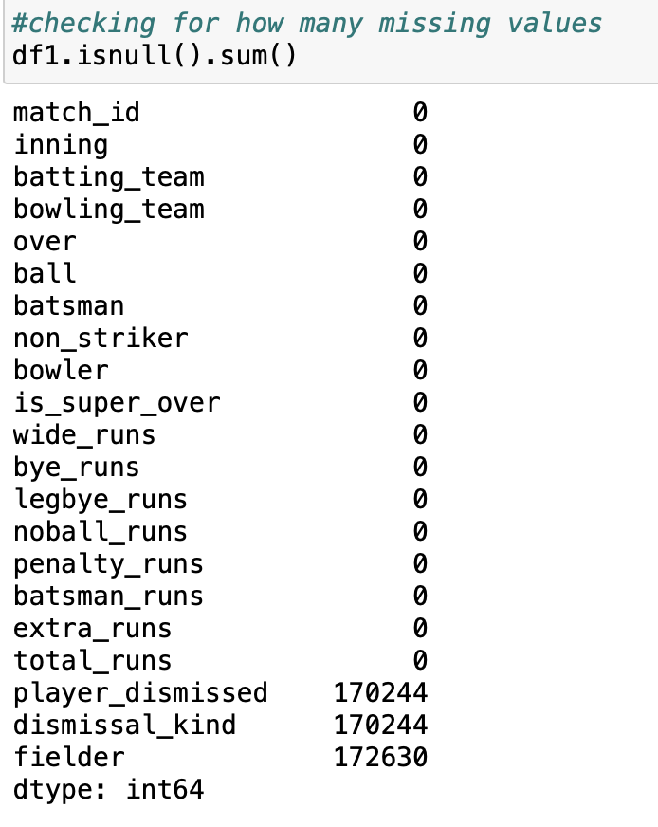
Checking the Missing Values in df1

Slide 10
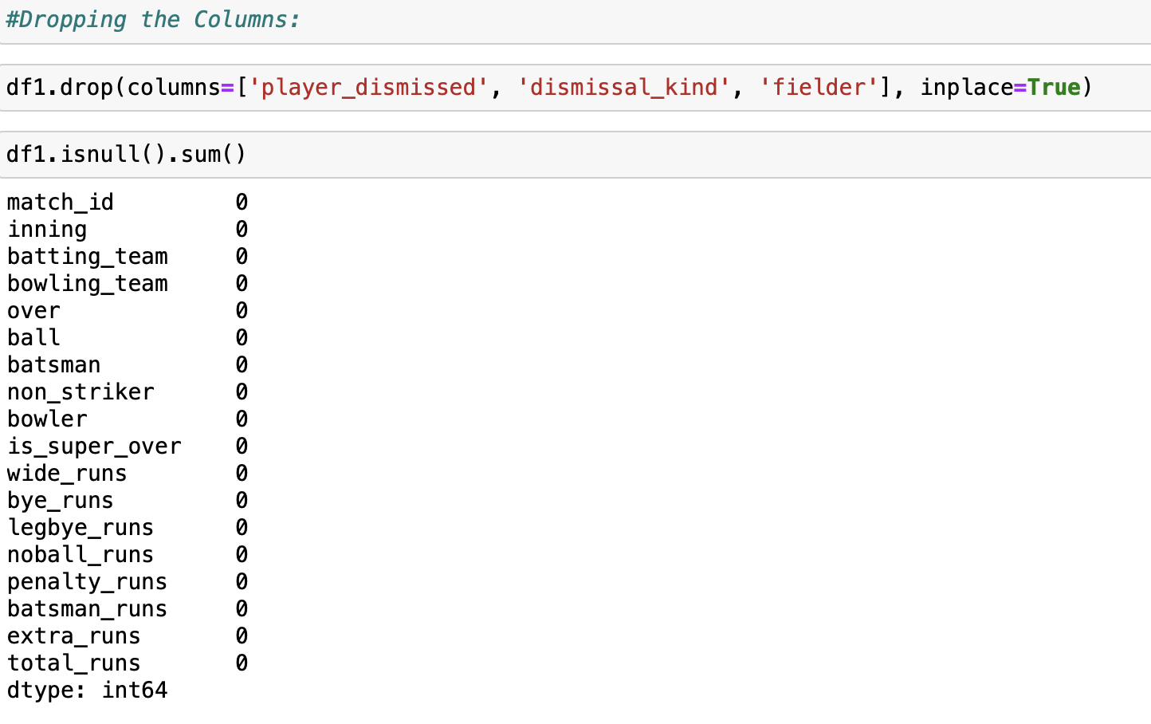
Dropping the columns

Slide 11
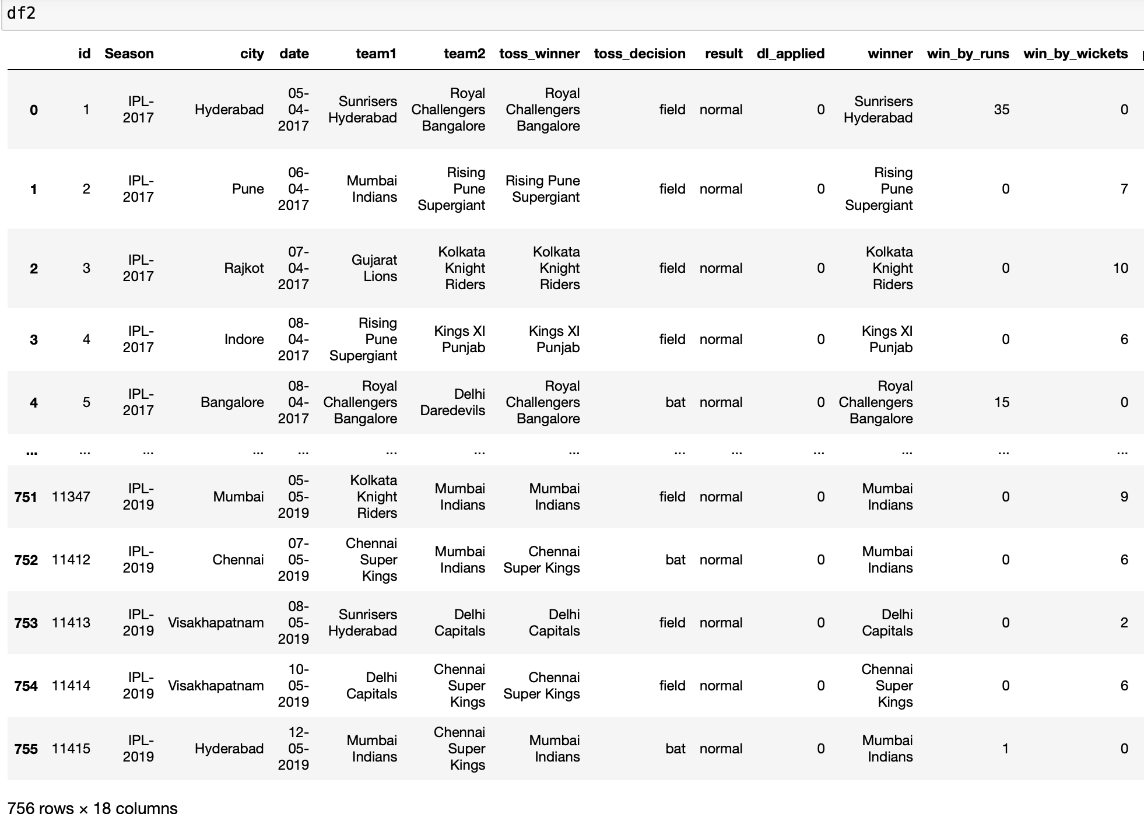
MATCHES.CSV

Slide 12
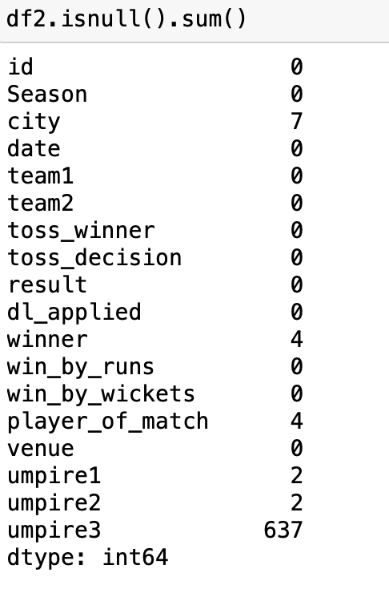
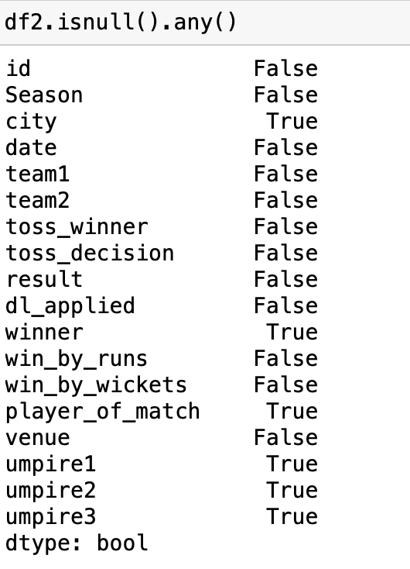
Checking the Missing Values in df2

Slide 13
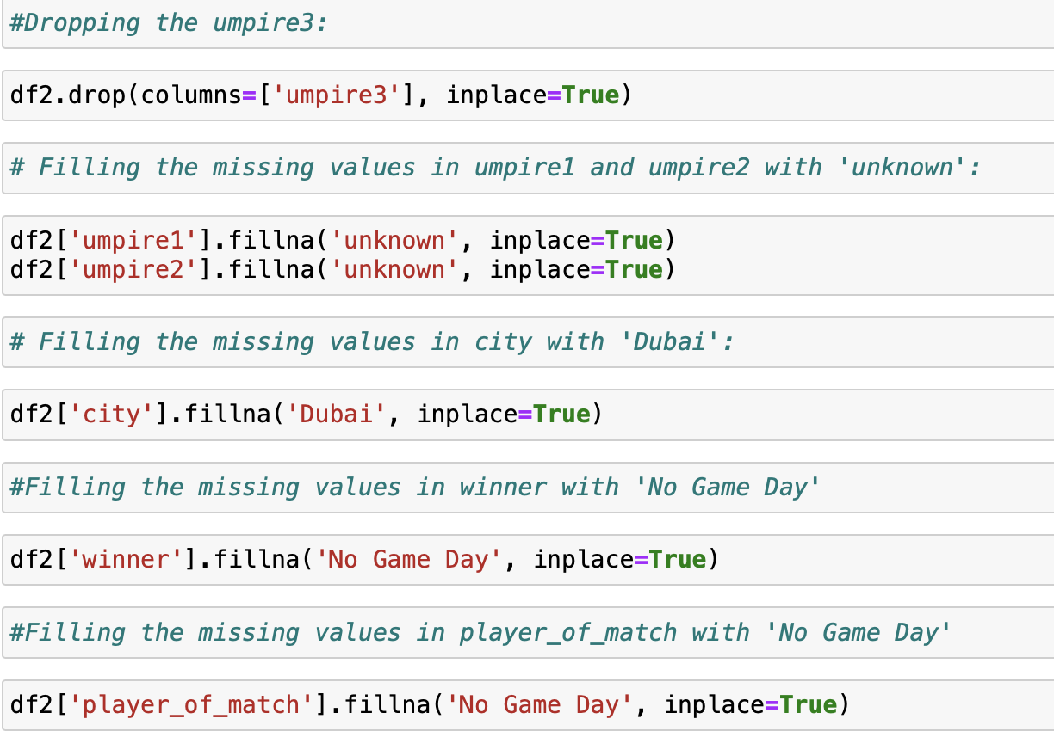
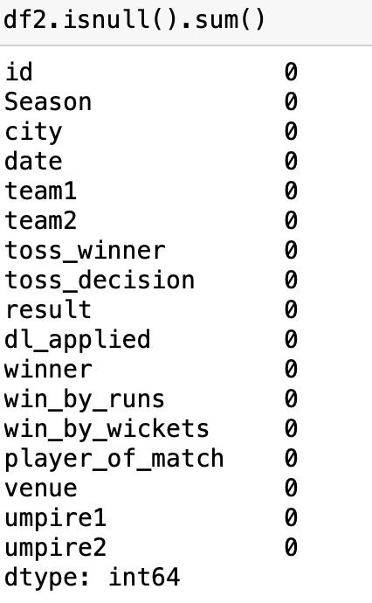
Handling the missing values

Slide 14
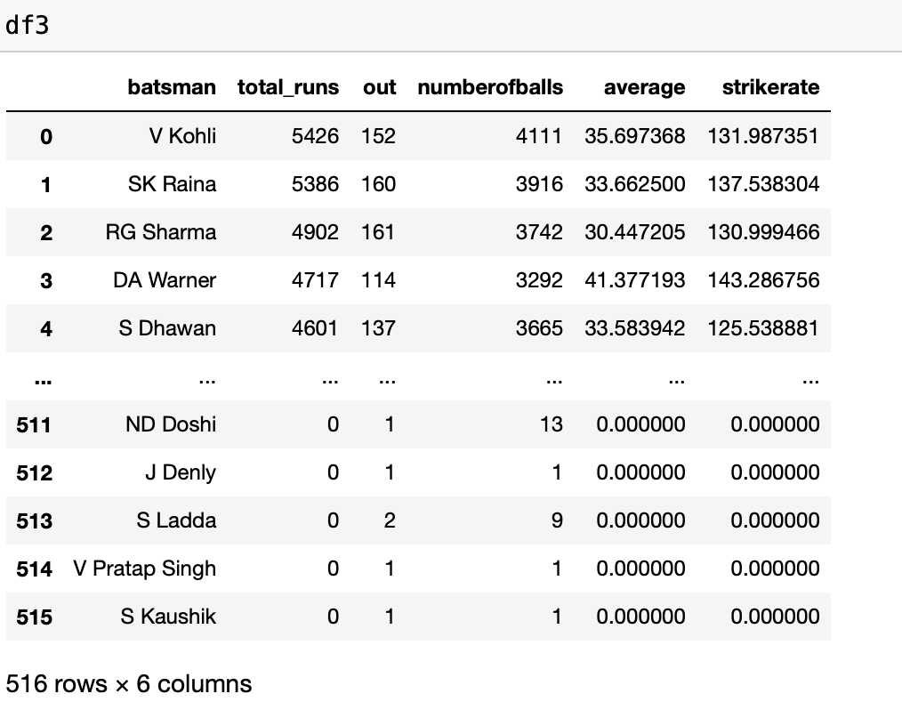
MOST_RUNS_AVERAGE_STRIKERATE.CSV

Slide 15
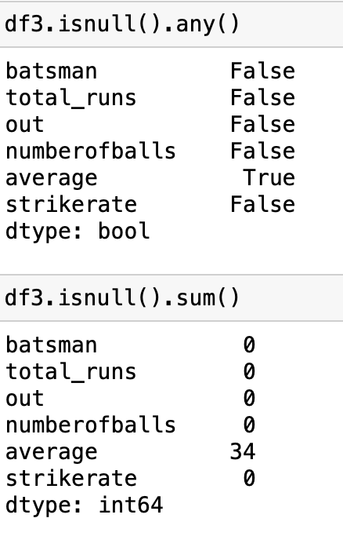
Checking the Missing Values in df3

Slide 16
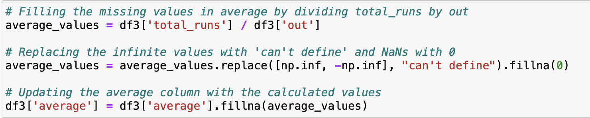
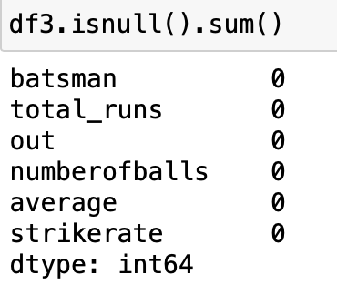
Handling the missing values

Slide 17
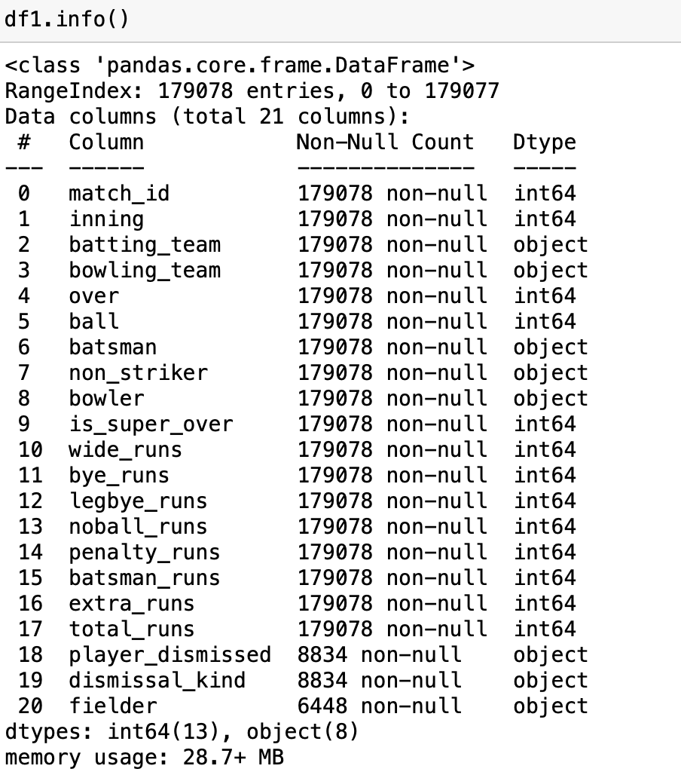
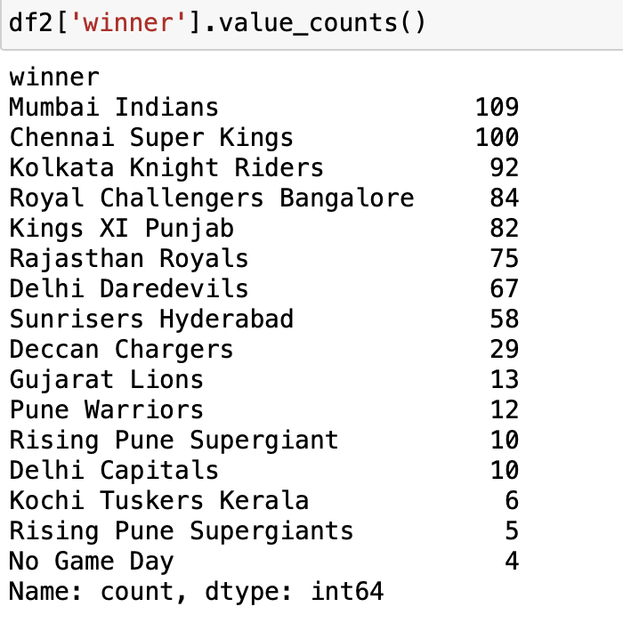
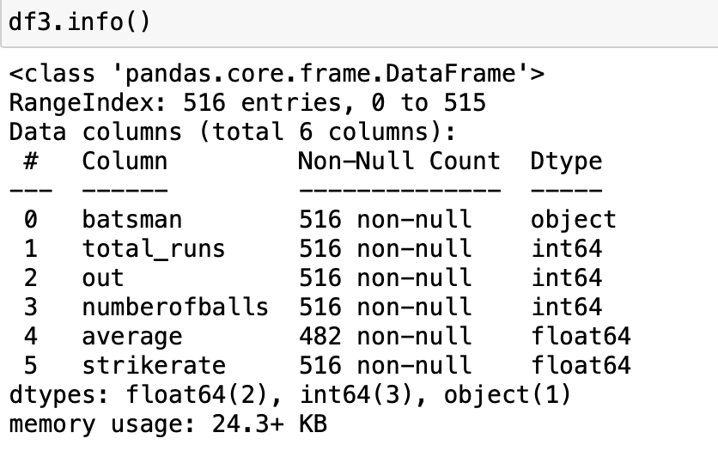
CHECKING THE DUPLICATES

Slide 18
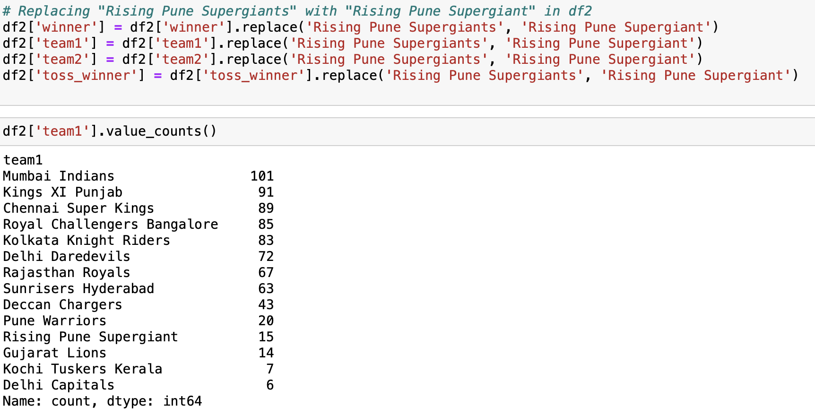
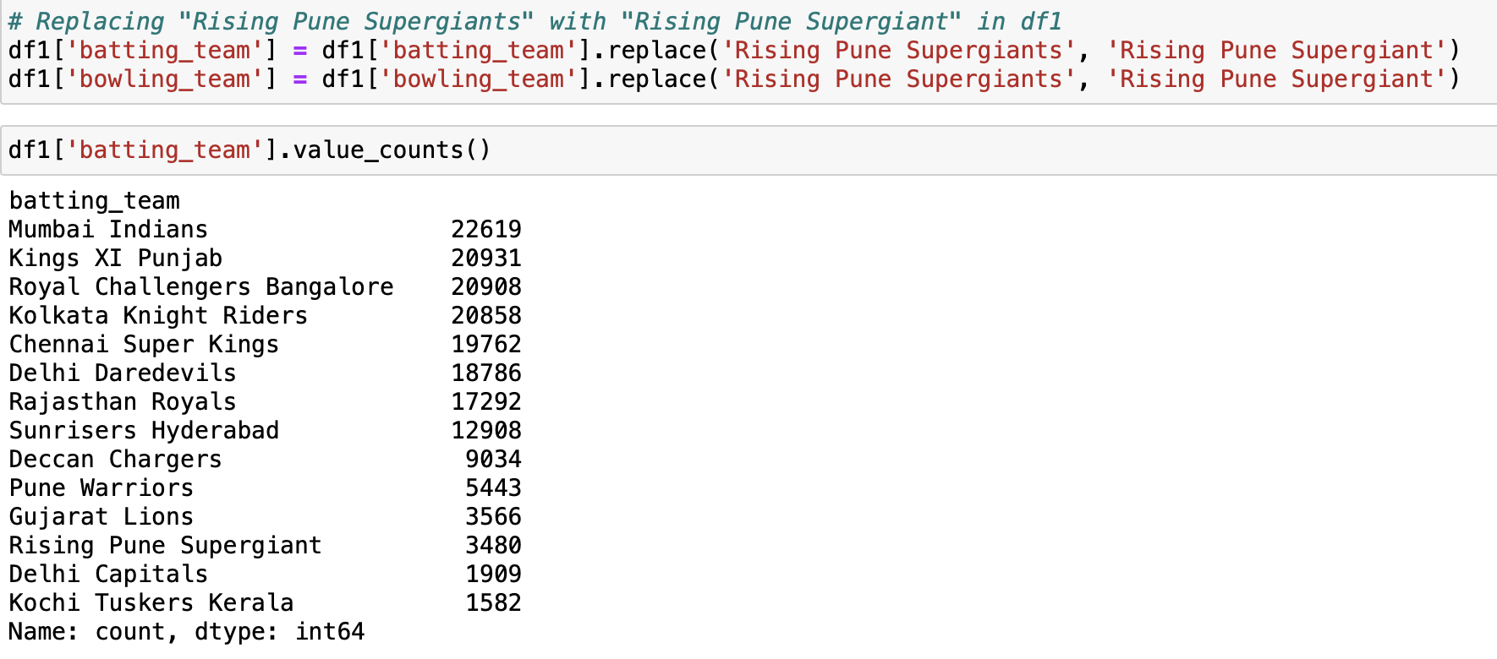
Handling the Duplicates

Slide 19
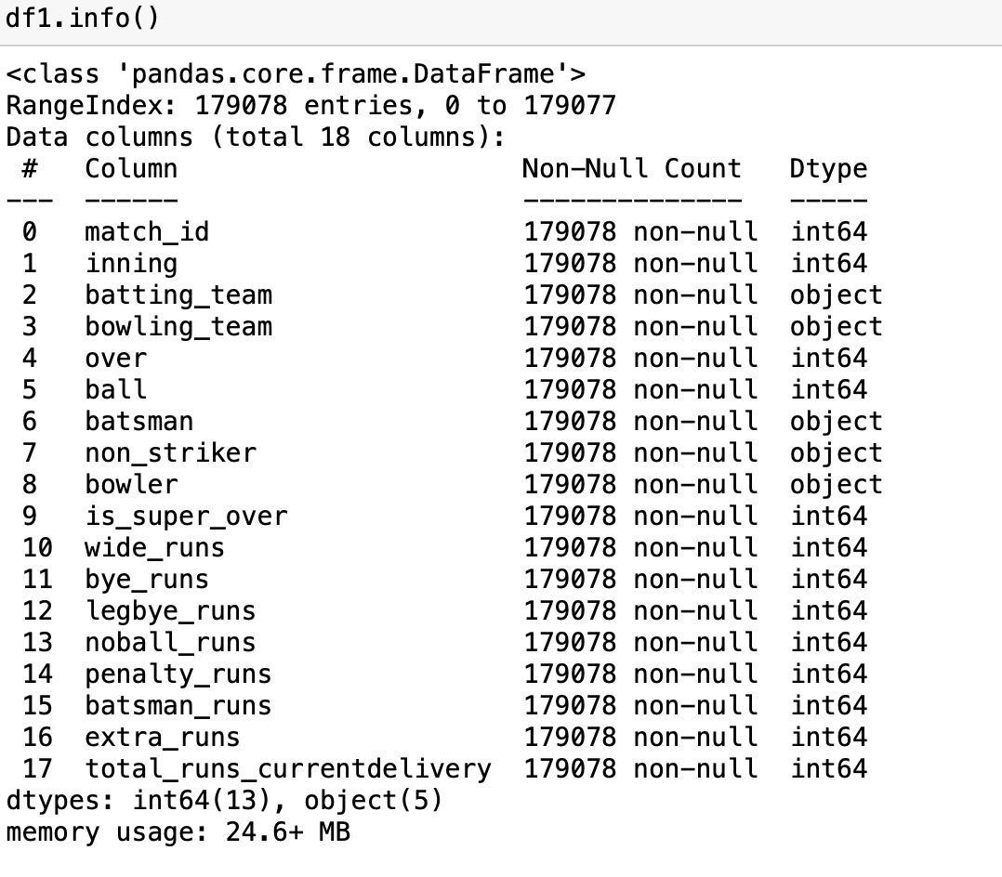
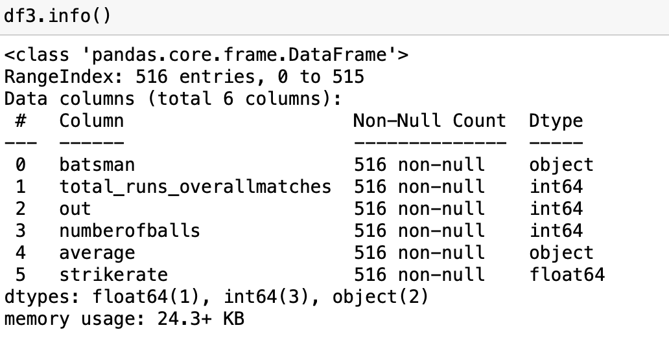
Changing the column names

Slide 20
DESCRIPTIVE STATISTICS

Slide 21
Summary Statistics
Summary statistics provide a concise overview of key characteristics within a dataset, including measures such as mean, median, minimum, maximum, and standard deviation, offering insights into central tendencies, variability, and distribution of the data.

Slide 22
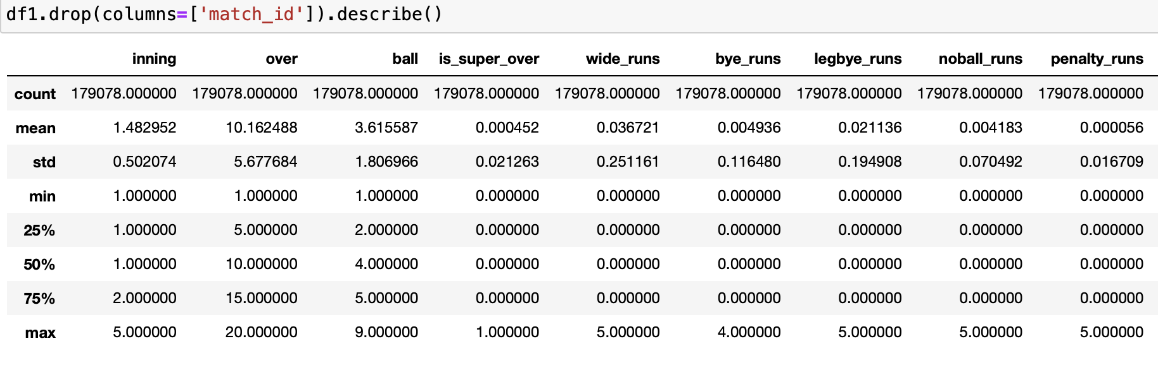
Summary Statistics – df1

Slide 23
Observations from Summary Statistics – df1
Count: This indicates the total number of observations or data points available for each variable. For instance, there are 179,078 observations for each variable in the dataset.
Mean: The mean represents the average value of each variable across all observations. For example, the mean value for the 'inning' variable is approximately 1.48, suggesting that, on average, the matches in the dataset have an inning value close to 1.48.
Standard Deviation (std): The standard deviation measures the dispersion or spread of values around the mean. It indicates the degree of variability or deviation from the mean. For instance, a high standard deviation for the 'wide_runs' variable (0.25) suggests that there is considerable variability in the number of wide runs across observations.
Min: This denotes the minimum value observed for each variable in the dataset. For instance, the minimum value for the 'inning' variable is 1, indicating that the lowest inning number observed in the dataset is 1.
25th, 50th (Median), and 75th Percentiles: These values represent the first quartile (Q1), median (Q2), and third quartile (Q3), respectively. They divide the data into four equal parts. For example, the 25th percentile value for the 'over' variable is 5, indicating that 25% of the observations have an over value of 5 or lower.
Max: This denotes the maximum value observed for each variable in the dataset. For instance, the maximum value for the 'total_runs_currentdelivery' variable is 10, indicating that the highest total runs scored in a single delivery is 10.

Slide 24
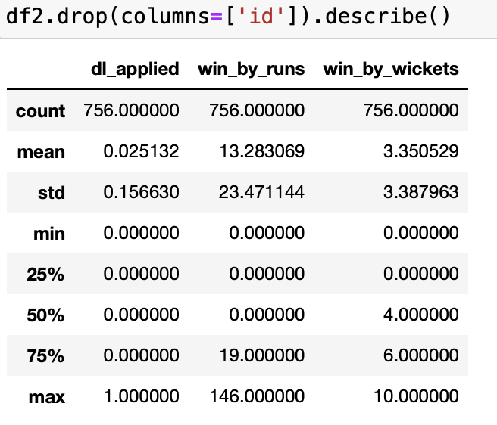
Summary Statistics – df2

Slide 25
Observations from Summary Statistics – df2
Count: 756 observations for each variable.
Mean: Around 3% matches had Duckworth Lewis method applied. Teams won by approximately 13 runs on average with around 3 wickets remaining on average.
Standard Deviation (std): Standard deviation is about 0.16 for dl_applied, around 23.47 for win_by_runs, and approximately 3.39 for win_by_wickets.
Min: Some matches had no Duckworth Lewis method applied, won the matches with no runs and also, won with no wickets remaining.
25th, 50th (Median), and 75th Percentiles: 25% had dl_applied=0, 50% had it=0, and 75% had it<=0. 25% had win_by_runs=0, 50% had it=0, and 75% had it<=19. 25% had win_by_wickets=0, 50% had it=4, and 75% had it<=6.
Max: Maximum value is 1, indicating Duckworth Lewis method applied in some matches for dl_applied. Maximum value is 146, indicating significant victory margins for win_by_runs. Maximum value is 10, showing matches won with 10 wickets remaining for win_by_wickets.

Slide 26
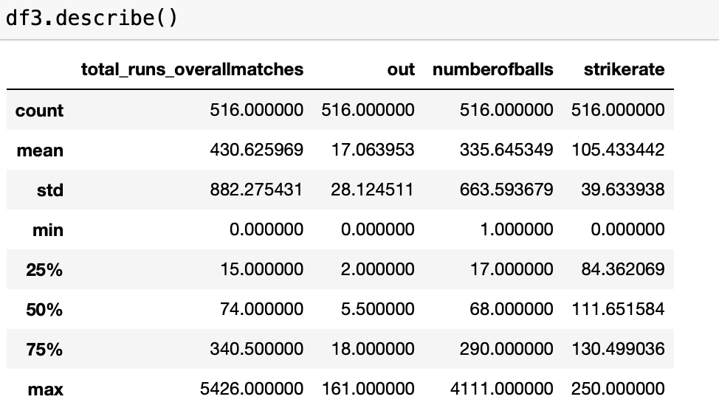
Summary Statistics – df3

Slide 27
Observations from Summary Statistics – df3
Count: There are 516 observations in the dataset for each variable, indicating the total number of data points available.
Mean: The mean represents the average value of each variable across all observations. For example, the average total runs scored overall matches is approximately 430.63, the average number of times out is about 17.06, the average number of balls faced is around 335.65, and the average strikerate is roughly 105.43.
Standard Deviation (Std): Standard deviation measures the dispersion or spread of the data points around the mean. A higher standard deviation indicates greater variability in the data. For instance, the standard deviation of total runs overall matches is 882.28, suggesting a wide range of scores across different matches.
Minimum (Min) and Maximum (Max): These values represent the smallest and largest observations in the dataset, respectively. For example, the minimum total runs scored overall matches is 0, while the maximum is 5426.
25th, 50th (Median), and 75th Percentiles: These percentiles divide the data into four equal parts, with 25% of the data falling below the 25th percentile, 50% below the median (50th percentile), and 75% below the 75th percentile. They provide insights into the distribution of the data. For instance, the median number of balls faced is 68, indicating that half of the observations faced fewer balls than this value.

Slide 28
Correlation Analysis
Correlation analysis examines the relationship between pairs of variables in a dataset, determining the extent to which changes in one variable correspond to changes in another, measured by the correlation coefficient, which ranges from -1 to 1.

Slide 29
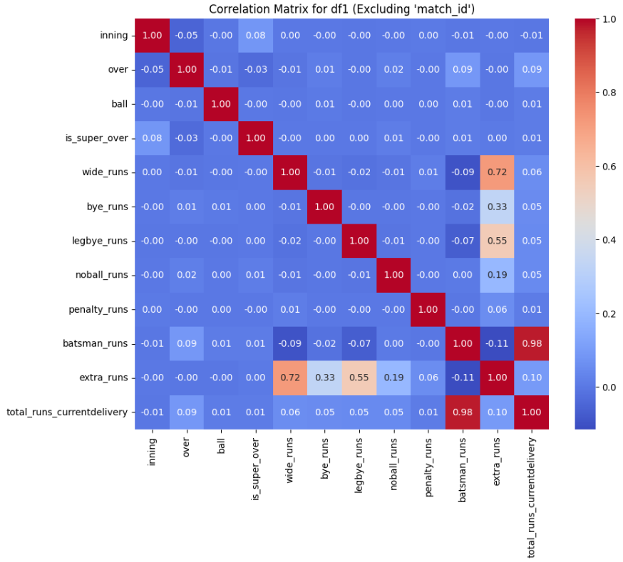
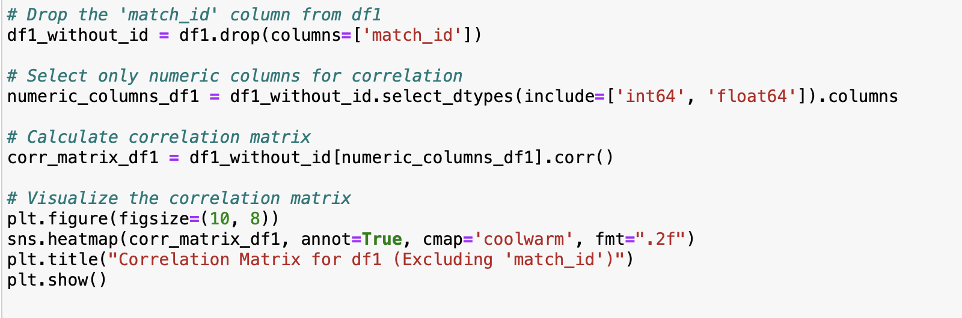
Correlation analysis – df1:

Slide 30
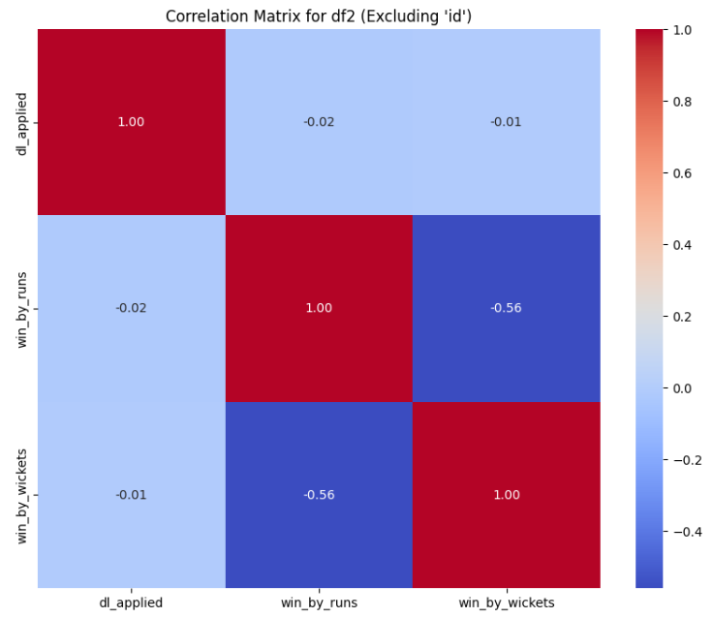
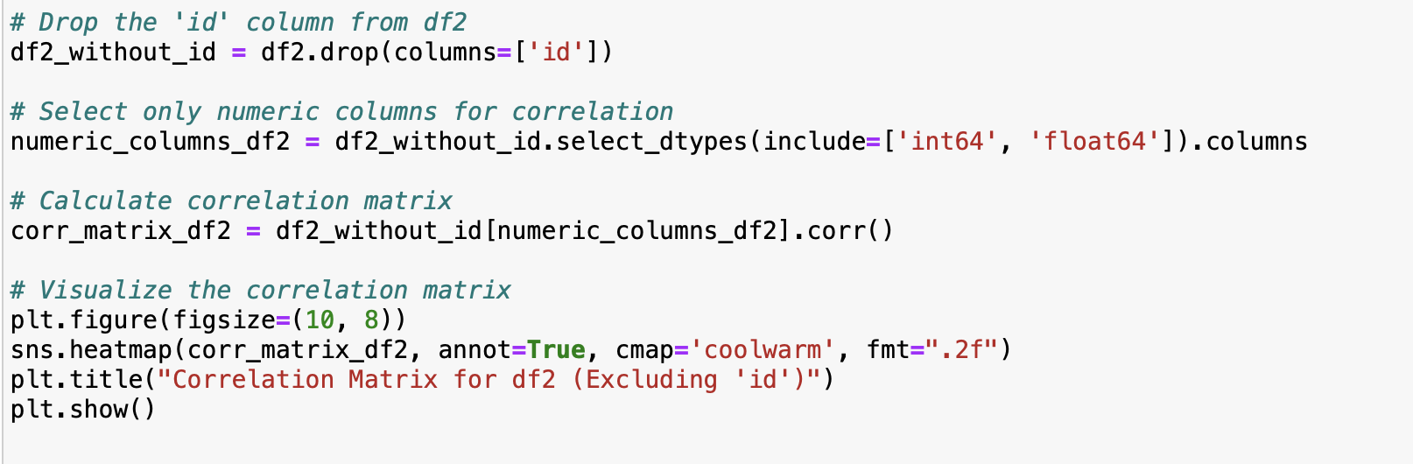
Correlation analysis – df2:

Slide 31
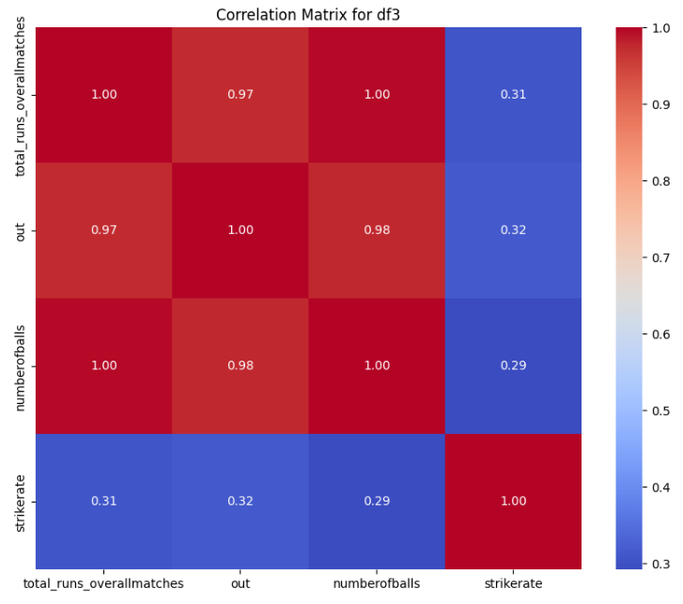
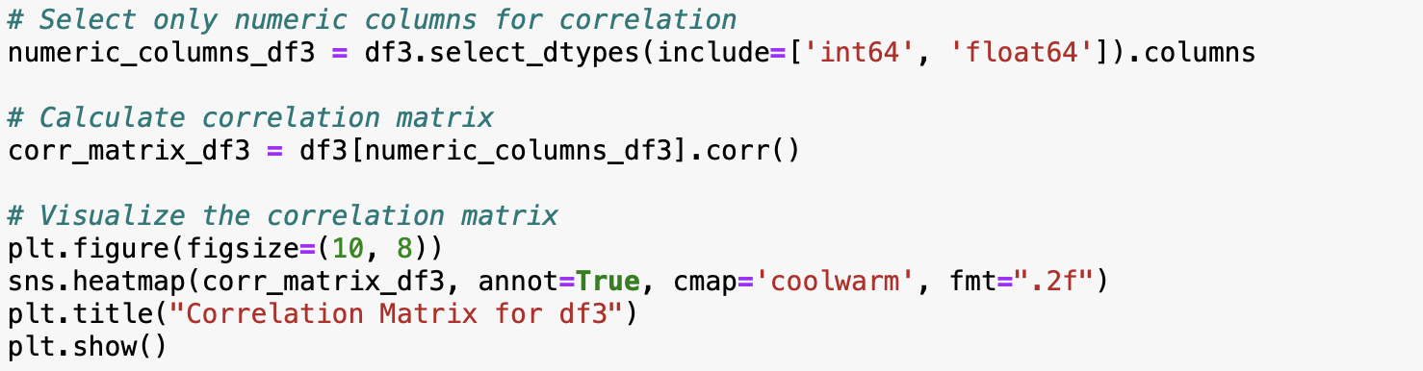
Correlation analysis – df3:

Slide 32
DATA MANIPULATION

Slide 33
Using Data Aggregation Technique
Data aggregation involves the process of gathering and summarizing data from multiple sources or across various dimensions to provide meaningful insights or simplify complex datasets.

Slide 34
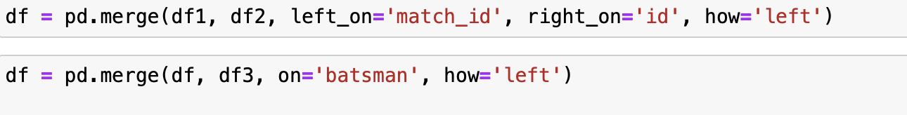
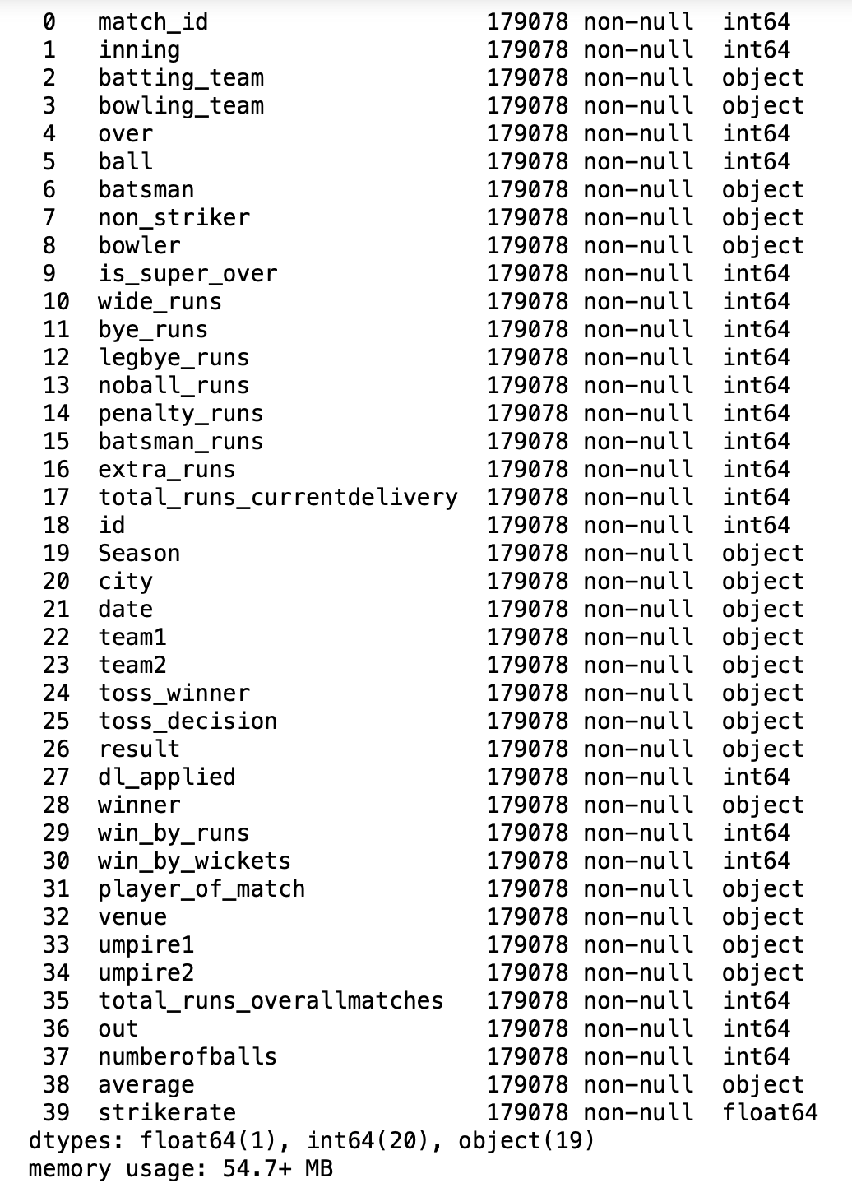
Data Merging
It involves combining information from multiple datasets into a single dataset

Slide 35
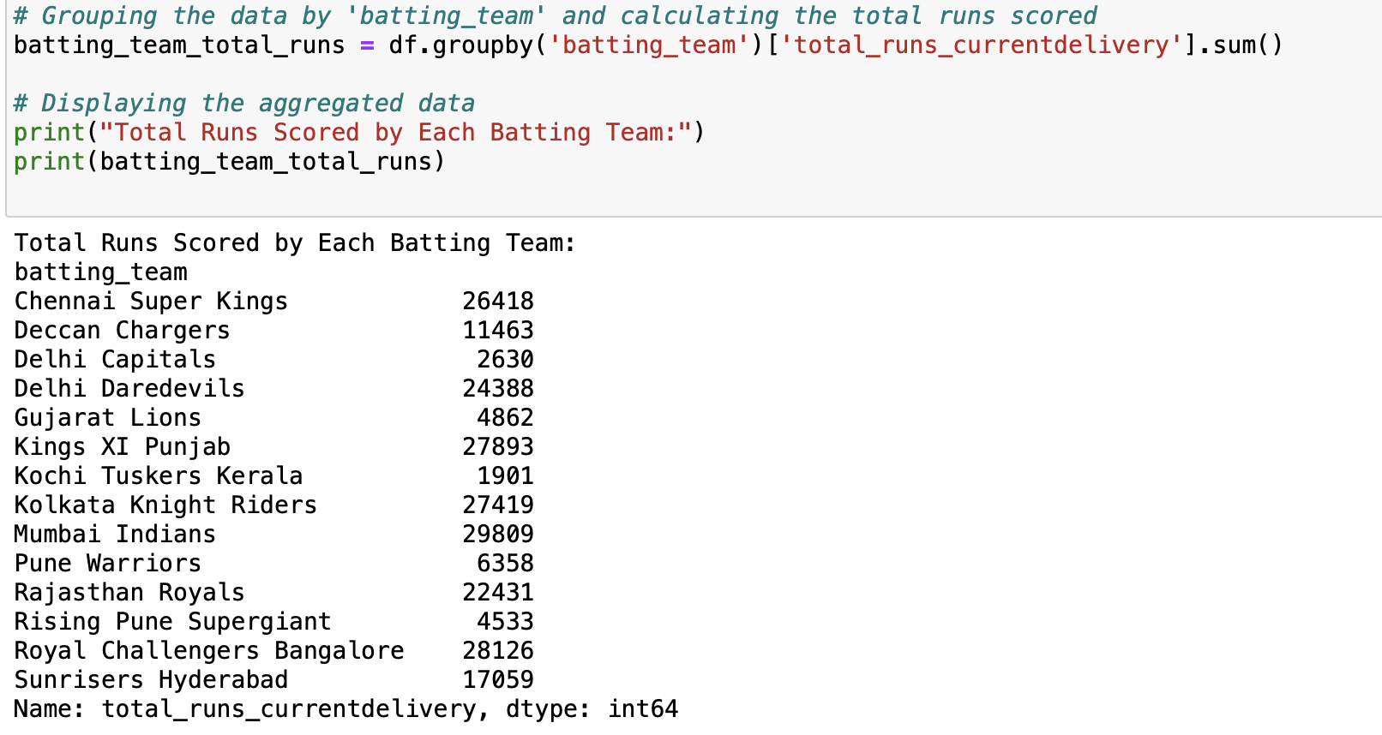
Data Aggregation that calculates the total runs scored by each batting team

Slide 36
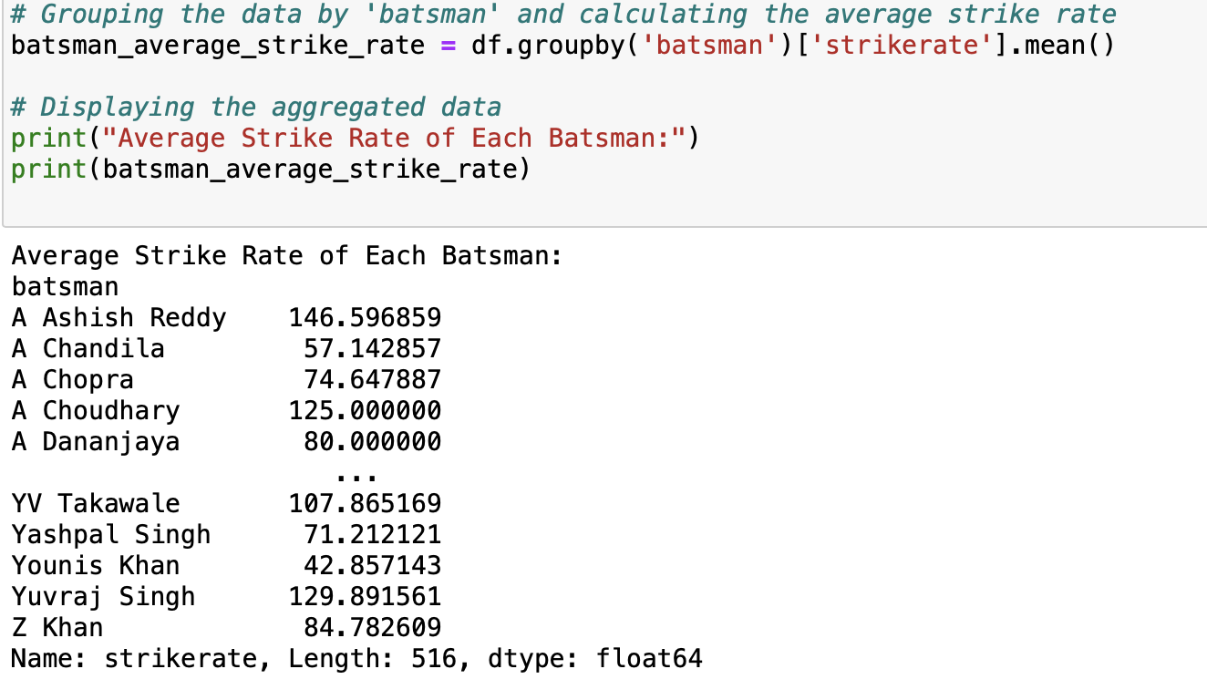
Data Aggregation that calculates the average strike rate of each batsman

Slide 37
DATA VISUALIZATION

Slide 38

Data Visualization
Data Visualization is data representation in a visual format such as charts, graphs, and plots. In this context, we have used four different types of visualization techniques to represent data:
Bar Chart
Line Chart
Stacked Area Chart
Stacked Bar Chart

Slide 39
Question 1: Which team has won the most matches in the dataset?

Slide 40

BAR CHART
Bar chart
A bar chart or bar graph is a chart or graph that presents categorical data with rectangular bars with heights or lengths proportional to the values that they represent. The bars can be plotted vertically or horizontally.
When to use it?
Compare categorical data.
Comparisons among discrete categories.
One axis of the chart shows the specific categories being compared, and the other axis represents a measured value.

Slide 41
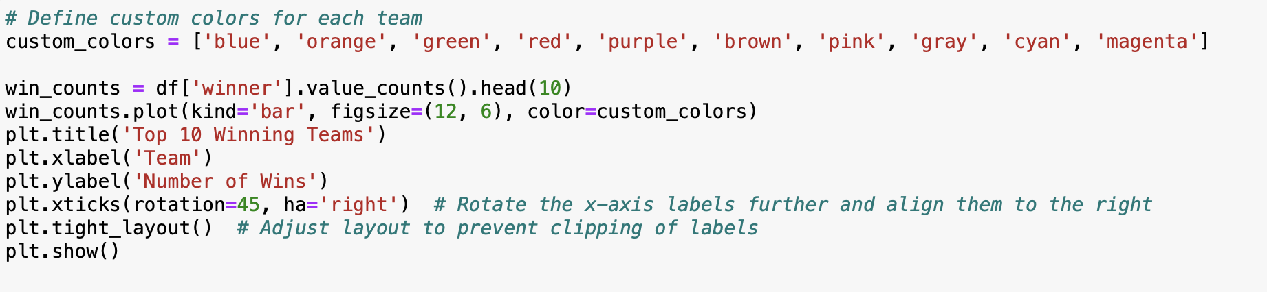
Code

Slide 42
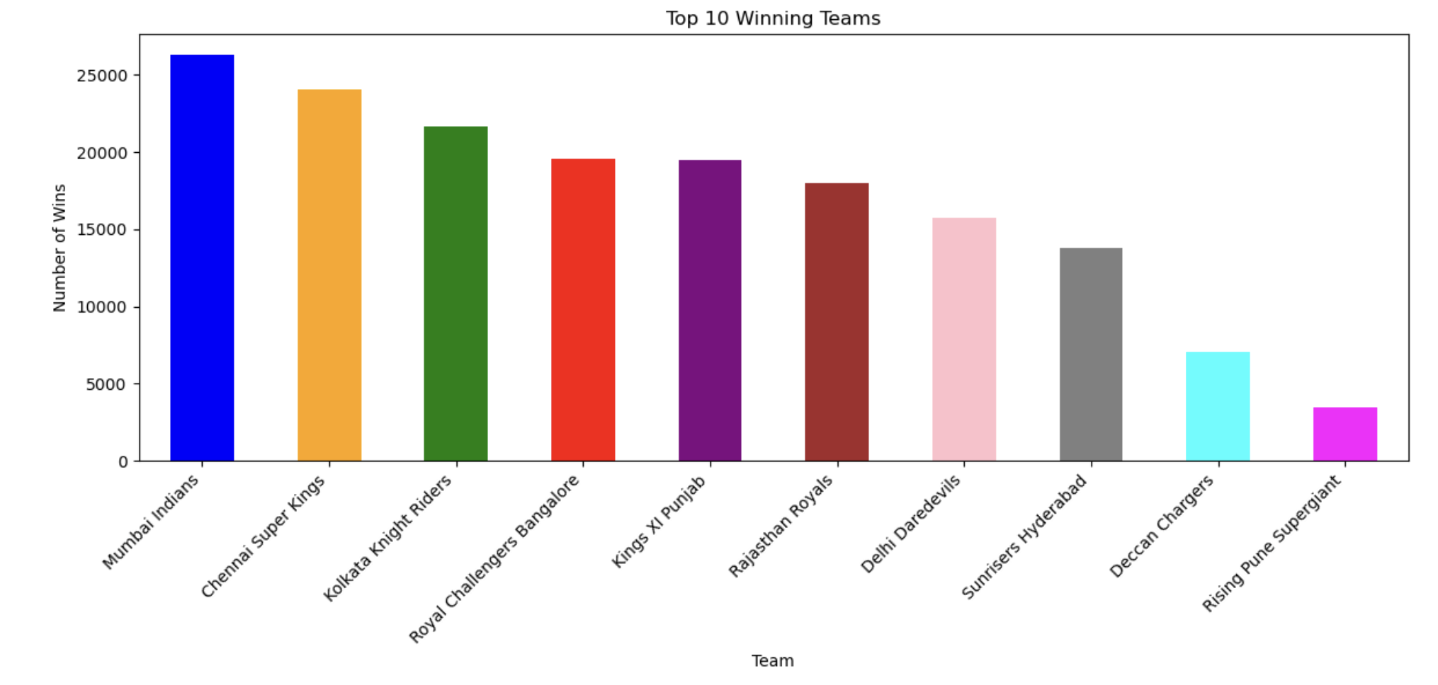
Bar Chart - Visualization

Slide 43
Observations
The bar plot illustrates the number of wins for the top 10 winning teams in the dataset.
Each bar represents a team, and its length corresponds to the number of wins accumulated by that team.
From the visualization, it is evident that Mumbai Indians hold the highest number of wins, followed by Chennai Super Kings and Kolkata Knight Riders.
The plot provides a clear comparison of the success rates among the top-performing teams, offering insights into their dominance in the league.
Overall, it showcases the competitive landscape of the teams in the dataset, with Mumbai Indians emerging as the most successful team based on the number of wins.

Slide 44
Marks and Channels Used:
Marks: Vertical bars represent the number of wins for each team.
Channels: Position (X-axis): Represents the teams. Position (Y-axis): Represents the number of wins. Length (Bars): Indicates the magnitude of wins for each team. Color (Bars): Could differentiate between different teams, although in this specific plot, all bars are the same color.

Slide 45
Question 2: How does the average run rate vary across different seasons?

Slide 46

LINE CHART
Line chart
A line chart or line graph is a type of chart that displays information as a series of data points called 'markers' connected by straight line segments. A line chart is often used to visualize a trend in data over intervals of time – a time series – thus the line is often drawn chronologically.
When to use it?
Track changes over time
The X-axis displays continuous variables
The Y-axis displays measurement

Slide 47
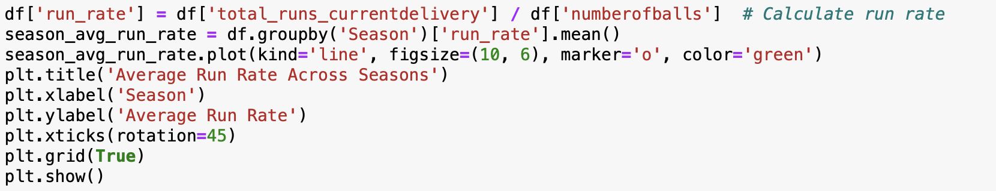
Code

Slide 48
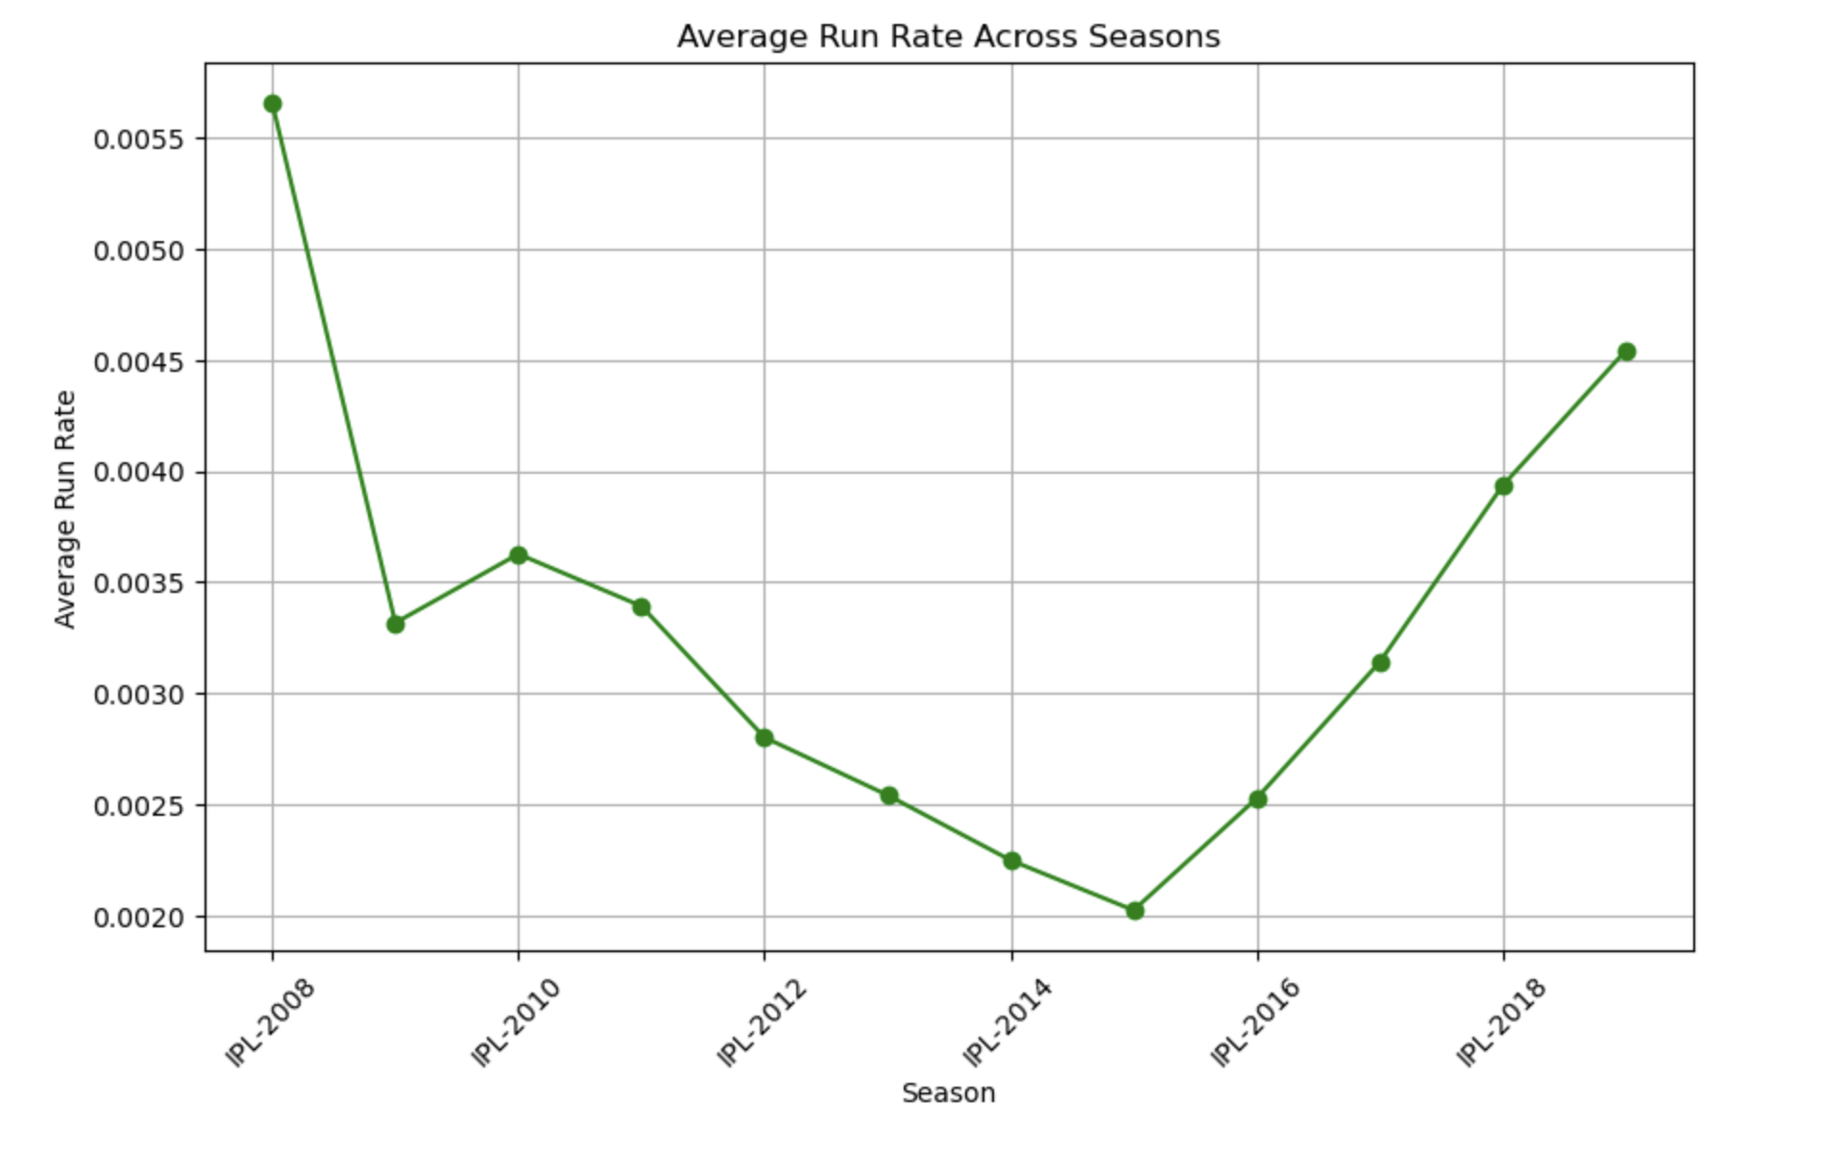
Line Chart - Visualization

Slide 49
Observations
The line plot depicts the average run rate across different seasons of the IPL (Indian Premier League).
It illustrates the trend of run rates over time, providing insights into the scoring patterns in each season.
From the graph, it's evident that there are fluctuations in the average run rate from season to season, with some seasons witnessing higher run rates compared to others.
The highest average run rate appears to be in the IPL-2019 season, while the lowest is observed in IPL-2015.
This analysis helps in understanding the pace of scoring in each IPL season and can be valuable for assessing the overall competitiveness and excitement of matches over the years.

Slide 50
Marks and Channels Used
Marks: points along the line where data is plotted, The markers specified by marker='o' indicate each data point along the line.
Channels: Position (X-axis): Represents the seasons. Position (Y-axis): Represents the average run rate for each season. Color (Line): The color of the line represents the data series (average run rate).

Slide 51
Question 3: What is the trend of total runs scored by each team over different seasons?

Slide 52
STACKED AREA CHART
Stacked area chart
Stacked Area Graphs work in the same way as simple Area Graphs do, except for the use of multiple data series that start each point from the point left by the previous data series.
When to use it ?
Represent cumulated totals using numbers or percentages over time. Visualize part-to-whole relationships, helping show how each category contributes to the cumulative total.

Slide 53
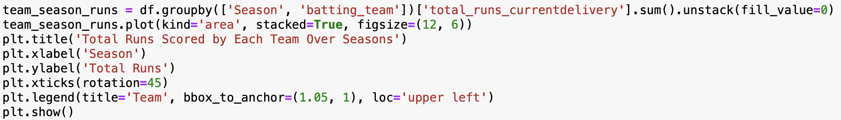
Code

Slide 54
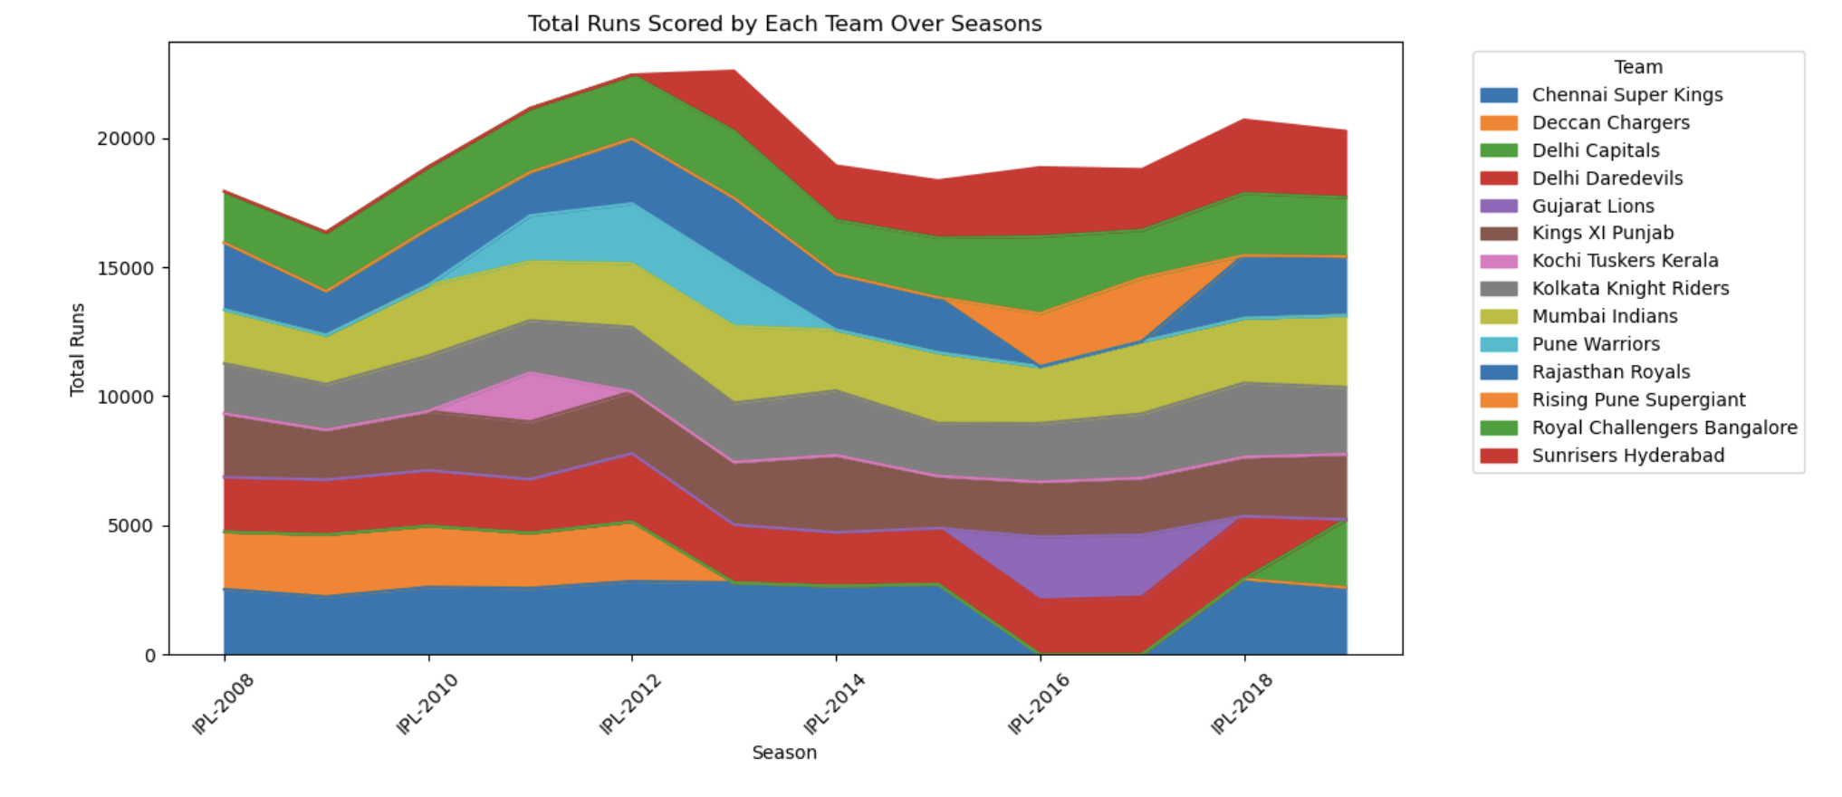
Stacked Area Chart - Visualization

Slide 55
Observations
The stacked area chart displays the total runs scored by each team over different seasons in the Indian Premier League (IPL).
Each color represents a different team, and the height of each color segment at any given point on the x-axis represents the total runs scored by that team in a particular season.
From the chart, we can observe the overall trend of runs scored by each team across seasons. For instance, teams like Mumbai Indians, Chennai Super Kings, and Royal Challengers Bangalore consistently appear to score higher totals across multiple seasons, indicating their strong batting performances.
On the other hand, some teams like Kochi Tuskers Kerala and Pune Warriors show lower total runs, possibly due to their shorter presence in the IPL or lower overall performance.
Additionally, fluctuations in the height of the colored segments within each season reveal variations in the performance of teams from one season to another.
This visualization provides insights into the batting prowess of each team over time and can help in analyzing the historical performance and trends of IPL teams in terms of run-scoring abilities.

Slide 56
Marks and Channels Used
Marks: Filled areas represent the total runs scored by each team.
Channels: Position (X-axis): Represents the seasons. Position (Y-axis): Represents the total runs scored. Color (Areas): Differentiates between teams. Each team's area is filled with a different color.

Slide 57
Question 4: How does the frequency of matches played vary across different venues?

Slide 58
STACKED BAR CHART
Stacked bar chart
Alternatively, a stacked bar chart could be used. The stacked bar chart stacks bars that represent different groups on top of each other. The height of the resulting bar shows the combined result of the groups.
When to use it ?
To compare the totals and one part of the totals. If the total of your parts is crucial, stacked column chart can work well for dates.

Slide 59
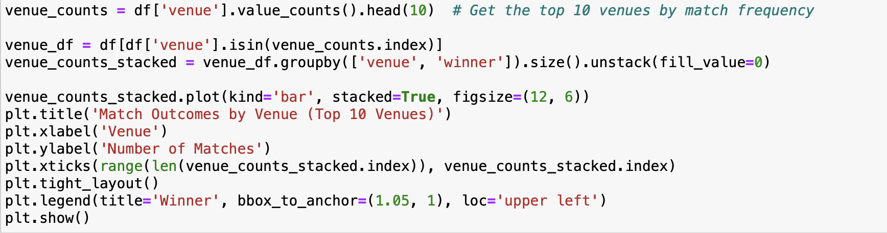
Code

Slide 60
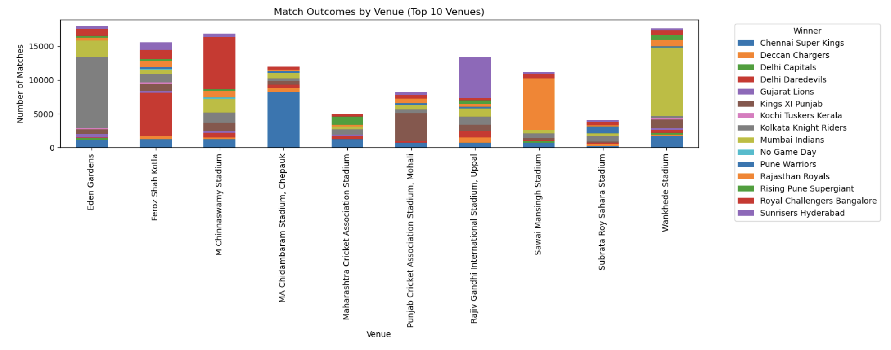
Stacked Bar Chart - Visualization

Slide 61
Observations
The stacked bar chart representation above shows the frequency of matches played at the top 10 venues, along with the number of matches won by each team at those venues.
Each row corresponds to a specific venue, and each column represents a team that has won matches at that venue.
For example, at the Eden Gardens venue, Kolkata Knight Riders won the highest number of matches, followed by Chennai Super Kings, and others.
Similarly, the bar chart provides insights into the match outcomes at other popular venues such as Feroz Shah Kotla, M Chinnaswamy Stadium, and Wankhede Stadium.
This table offers a comprehensive view of the match frequency and team performances across different venues, aiding in the analysis of venue preferences and team strengths in various locations.

Slide 62
Marks and Channels Used
Marks: Rectangular bars represent each category (venue). Different segments within each bar represent different categories (winners).
Channels: Position (X-axis): Represents the venues where matches were played. Position (Y-axis): Represents the number of matches played. Color (Segments): Differentiates between winners. Each segment of the bar is colored according to the winning team.

Slide 63
CONCLUSION
Team Performance:
Mumbai Indians emerge as the most successful team with the highest number of wins.
Chennai Super Kings and Kolkata Knight Riders closely follow in the rankings.
Venue Popularity:
Eden Gardens, Feroz Shah Kotla, and M Chinnaswamy Stadium are among the most popular venues, hosting numerous matches.
Seasonal Trends:
Fluctuations in average run rates across seasons indicate evolving game dynamics and strategies.
Decision Making Insights:
Stakeholders can leverage these insights to make informed decisions regarding team strategies, venue selections, and understanding seasonal variations.

Slide 64
Thank You

